Slide 1
Prefixes
and
Suffixes

Slide 2
A prefix is a word part added to the beginning of a root word.

Slide 3
A prefix changes the meaning of a word.

Slide 4
A suffix is a word part added to the end of a root word.

Slide 5
A suffix also changes the meaning of a word.

Slide 6
Prefixes We Know
Examples
im- not
in- not
bi- two
non- not
dis- not or opposite of
improper
incomplete
bicycle
nonstop
disagree

Slide 7
Suffixes We Know
Examples
-er one who
-or one who
-less without
-able, -ible can be
farmer
actor
useless
buildable
reversible

Slide 8
Prefixes: un- mis- dis- re- pre- post- under- over-
Suffixes: -ion -less -ment -ful -ness -able -ist -ical -er -ous -cy -ance/ence -(i)ty -ate -al -ive

Slide 9
Randy’s bike tire was flat. He couldn’t find the pump because the garage was in disorder. “It’s hopeless,” said Randy. “I’ll never make it to the soccer game on time.”

Slide 10
“That’s nonsense,” said his brother Jake. “You can use my bike.”

Slide 11
“Gee, thanks,” said Randy, hopping on the bike.

Slide 12
“See, I can be likable!” said Jake with a grin.

Slide 13
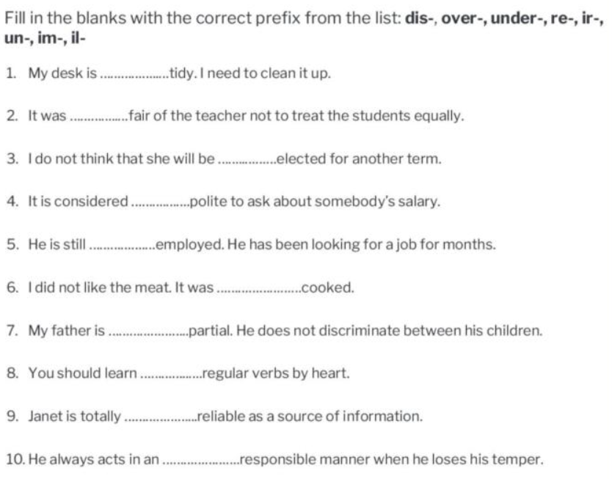

Slide 14
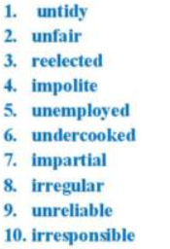

Slide 15
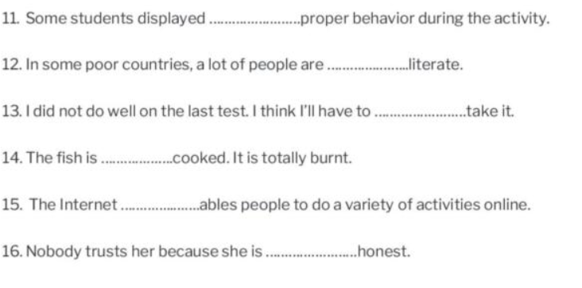

Slide 16
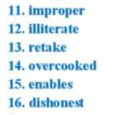

Slide 17
